Slide 1
Creating an MVC Web Site …using ASP.NET Core 1.0
See this Microsoft Tutorial on building your first ASP.NET Core MVC app
Reports bugs here: https://connect.microsoft.com/VisualStudio/Feedback
David Turton, Professor
Conestoga College
Institute of Technology and Advanced Learning
dturton@conestogac.on.ca
Doon 2A605 519-748-5220 x3610

Slide 2
Upgrade Visual Studio 2015 to Update 3 … and add tooling for .NET Core
Microsoft is evolving ASP.NET MVC 6 & .NET Framework 5
To ASP.NET Core 1.0 & .NET Core 1.0
Completely revised architecture
Better MVC & Web API integration
More efficient for large-scale sites
Upgrade PowerShell to version 5
Upgrade to Visual Studio 2015 Update 3
Add .NET Core 1.0 to Visual Studio 2015

Slide 3
ASP.NET Web Forms
Active Server Pages (ASP)
Microsoft's dynamic web pages
Pages populated using data from a database
Around since late 90's
Originally script-inside-HTML (VB, C++, J++)
.NET 2003 → "web forms"
GUI drag-and-drop design, like Windows forms
Controls: GridView, DetailsView, Master Page
Rendered to XHTML
Code was in a separate file
__ViewState – hidden on web page: server's crib-sheet
… could be quite huge … an impact on large sites

Slide 4
ASP.NET MVC
C
MVC first released 2008
Model-View-Controller
Controller (code)
Reads data through a model (class file)
Selects the appropriate view (web page)
Passes data to the view in ViewData (aka ViewBag)
Receives <form> data via HTML POST
Writes to database through a model
Naming convention:
Controller names always end with "Controller"
But, when referring to them, drop the "Controller"
M
V

Slide 5
ASP.NET MVC
C
Model
A set of classes to describe data
Like the Domain Class Model with relations
Also known as Data Access Layer (DAL) classes
Describes properties/relations, what data is valid & how it's displayed
Using validation code & annotations in model
View Model
Used to convey objects that don't exactly match database tables
We'll be using Entity Framework & LINQ
These generate SQL for us
… and can apply SQL functionality to in-memory objects and collections
M
V

Slide 6
ASP.NET MVC
C
View (web page)
Describes how the page is displayed
Each controller action (method) can have its own view
Uses CSS3 and HTML5
~/Views/_ViewStart.cshtml
Identifies default layout (aka master page) to be used
A framework into which Individual views are inserted
Razor engine merges data & generates some HTML
Saves you having to write complex/repetitive HTML
Example: @Html.ValidationSummary()
Builds an unordered list of all the validation errors in the model
M
V

Slide 7
Razor Engine
A templating engine to render HTML
Introduced in MVC 3
Allows you to reference data passed from the controller
Just put "@" followed by C# code or a variable name
Creates HTML from Tag Helpers (prior releases used HTML Helpers)
<label asp-for="Price" class="col-md-2 control-label"></label>
<div class="col-md-10">
<input asp-for="Price" class="form-control" />
<span asp-validation-for="Price" class="text-danger" />
</div>
Create a label and datatype-sensitive input field for Price
If a model was provided, pre-load the value of the field Price
If there's an edit error for Price, display that too

Slide 8
Convention Over Configuration
MVC has a lot of assumptions (conventions)
Views are in ~/Views
In a sub-folder named after the controller
Default primary key for a Model:
Field with the model's name followed by "ID" or "Id"
If you follow the conventions:
Everything links together without qualifying
Your system is familiar to other programmers
You don't have to follow the conventions
You become responsible for linking it together
Harder to maintain → constantly re-learning unique technique

Slide 9
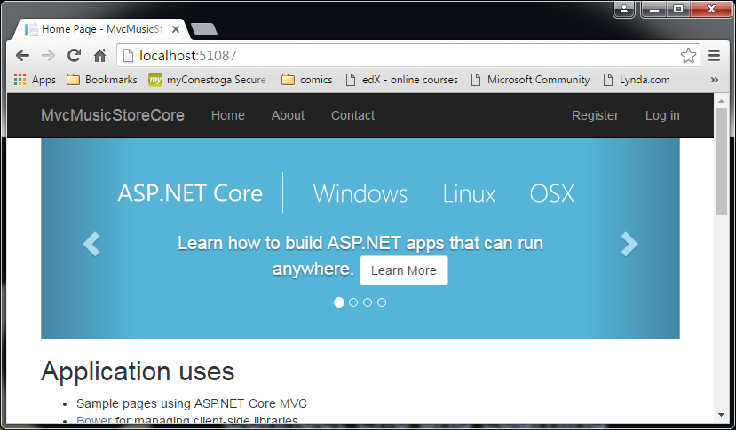
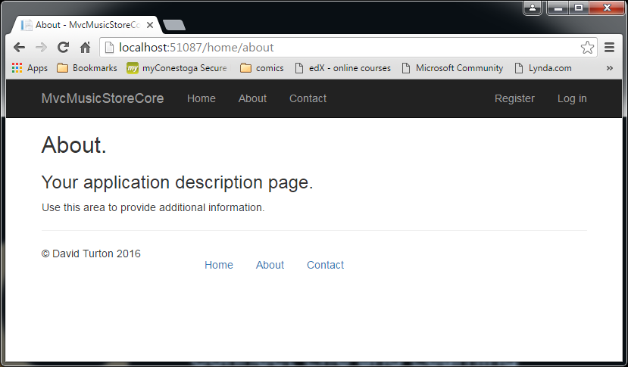
URLs specify controller & action, not page http://site/controller/action/id - no action specified → Index assumed - no controller specified → Home assumed → meaning HomeController.cs

Slide 10
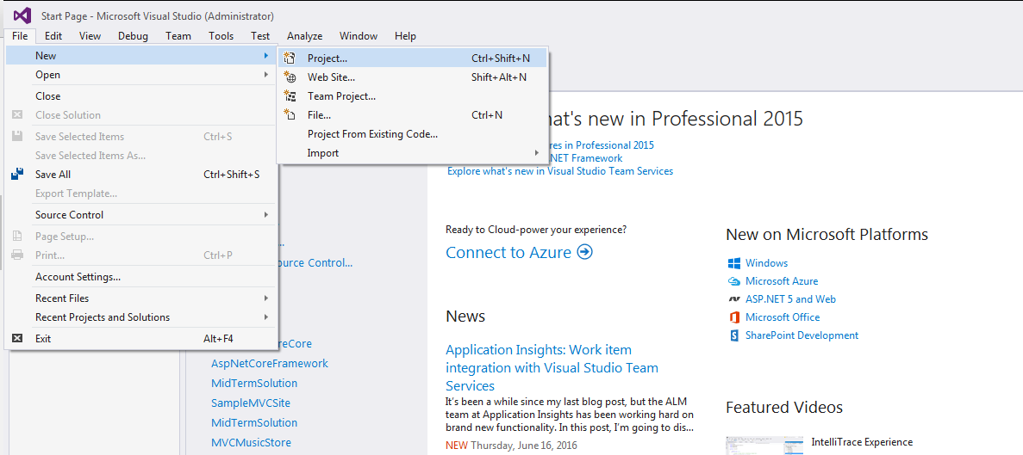
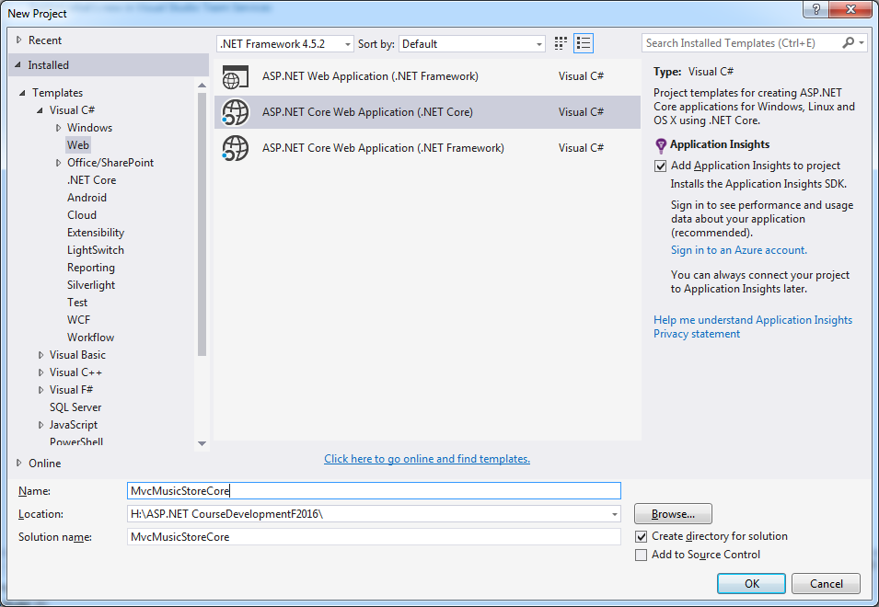
Create a new Project using ASP.NET Core

Slide 11
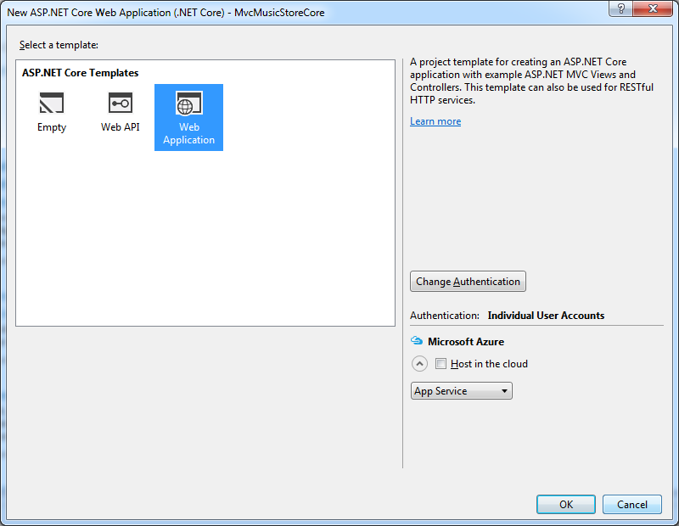
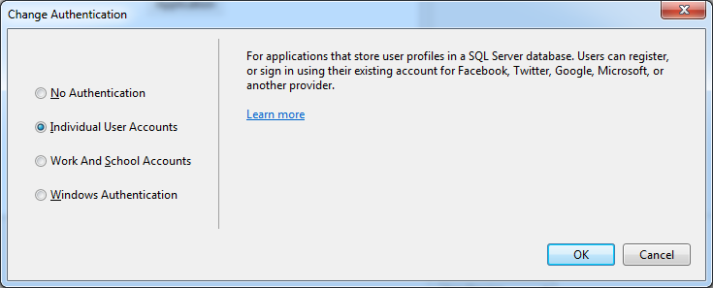
Specify "Web Application" - this provides the basic MVC structure
Include authentication:
It's very hard to add later
Used to permit & deny access
Users belong to roles
Web pages & functions can be restricted to specific roles
Individual user accounts
Authenticates using a User/Role database
Work and school accounts
Authenticates using Active Directory, Azure or Office 360 accounts
Windows Authentication
Permit & deny based on current username

Slide 12
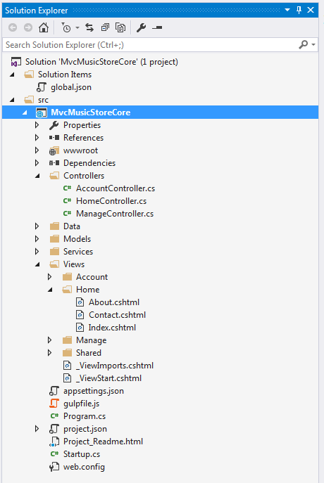
Structure of an MVC Project
A solution can contain multiple projects
Web site, unit-tests, class libraries, etc.
MVC
Controllers (business logic layer)
Code driving web pages
Accesses and maintains database tables
Decides which view to return, passes data to view
Models
Describe data such as database tables
Used by controller to pass data to database & views
Contain data validation code & annotations
Views (presentation layer)
HTML5/CSS3 augmented with Razor code
Conveys data from controller to user
Conveys user input to controller
One sub-folder under Views for each controller
Controllers have multiple views

Slide 13
Code-First or Data-First Approach?
Code First
You provide the Design Class Models & context class
One model per database table
Create the database & tables using Migrations under Package Manager
Can write "seed" code to initialise table data
If you modify the models or context, site will refuse to use current database:
Must migrate model/context changes to the database (data is usually retained)
Data First
You provide an existing database
…with existing data
Use Package Manager to generate the models & context
If you modify the database tables:
Delete & re-generate the models

Slide 14
Data-First Approach
Attach or create database on SQL
Start Package Manager console
Scaffold (generate) context & models
Implement dependency injection

Slide 15
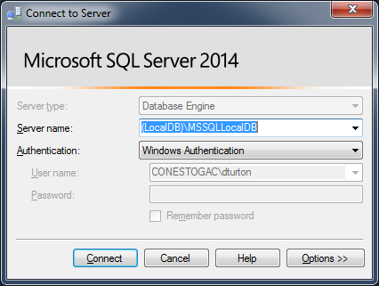
SQL Server Management Studio
SQL Server can be installed multiple times
Each instance has a unique name & its own collection of databases
…all use the same SQL Server program files
Default instance name for SQL Server Express Edition:
(local)\SqlExpress or .\SqlExpress ("." means "local computer")
Checkbox to also install (localDB)\MsSqlLocalDB
…this is Visual Studio 2015’s default instance:
Tools→Options→Database Tools→DataConnections
Instance names are not case sensitive

Slide 16
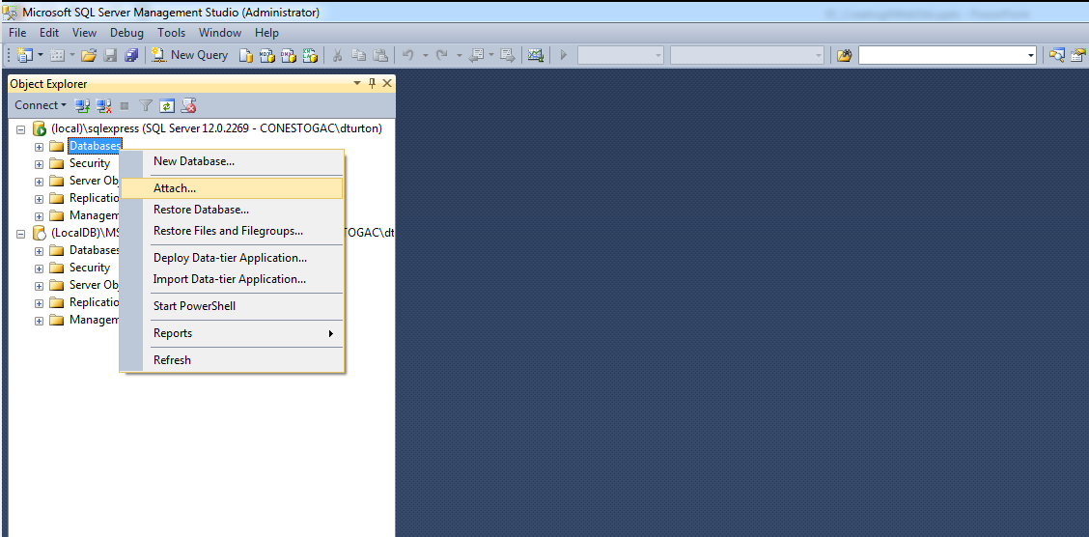
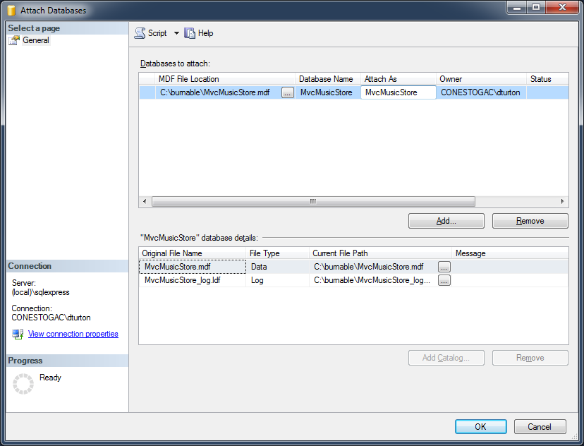
Create Database option 1 – attach an existing database .mdf file
You can change the displayed name
The actual database name is the .mdf file-name
Navigate to .mdf file

Slide 17
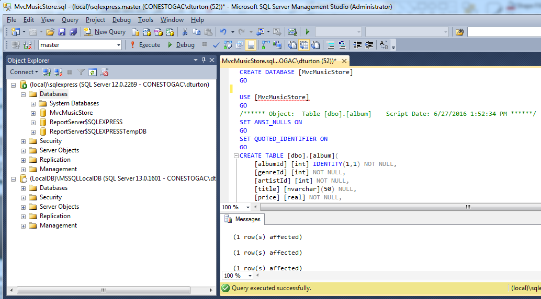
Create Database option 2 – create database from .sql script
Select the instance where you want the database
I'm showing 2 instances:
- (local)\SqlExpress
- (localDB)\MsSqlLocalDB
Open or paste the .sql query
Execute the query
huh …
SQL Server 2014 SQL version 12.x.x
SQL Server 2016 SQL version 13.x.x
Refresh…

Slide 18
Create Database option 3 – manually type database & tables
Uh … no … this isn't a database course
Of course, on Visual Paradigm, you could
Generate an ERD from your Detail Class Model
Generate an SQL script from the ERD (target SQL Server)
Run the script under SQL Server Management Studio

Slide 19
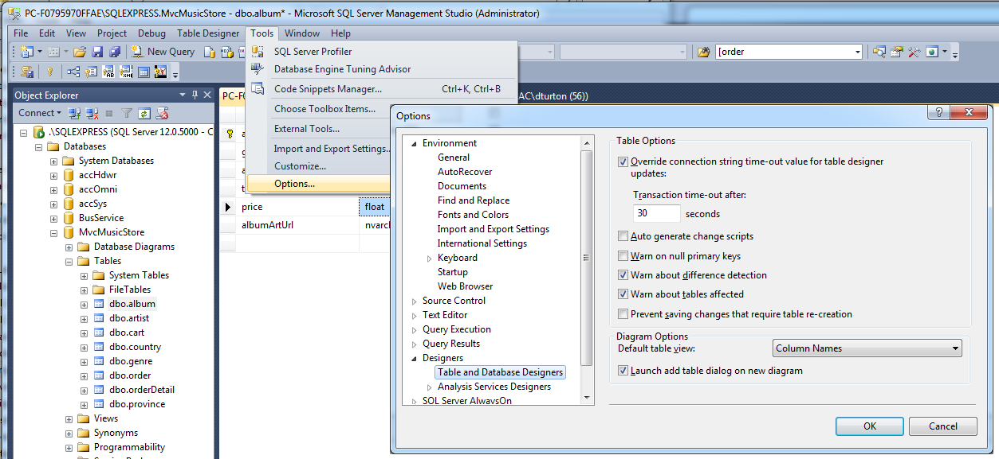
Note … when changing database schema - default won’t let you change table properties if it has data
Clear this … then can save table changes & retain its data

Slide 20
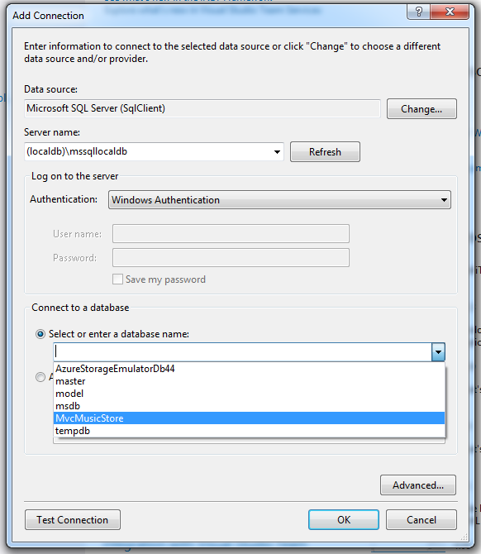
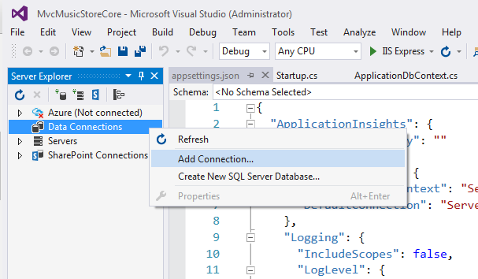
Open Database in Visual Studio (Server Explorer window)
I'm using the (localdb)\mssqllocaldb instance because it's the default for Visual Studio 2015.
I'd prefer to use .\sqlexpress because it's easier to remember … just ensure the connection string keeps up.

Slide 21
Reverse-Engineer (Generate) the models
Bring up the package manager console in Visual Studio:
Tools → NuGet Package Manager → Package Manager Console
The starting folder is assumed to be the solution's default project
You can use dir and cd commands to navigate to another folder.
Generate the scripts and context (typed all on one line):
-Connection connection string … could use "Server=.\sqlexpress;…
-Provider database "driver" … SQL Server vs MySql vs Oracle …
-OutputDir target directory & the namespace of the generated classes
-Context name of the context class it'll generate
-Verbose just what it says … in case there's problems
-Force when regenerating the models, this says “overwrite the old ones”
Scaffold-DbContext –Connection "Server=(localDB)\MsSqlLocalDb;Database=MvcMusicStore;Trusted_Connection=True;" -Provider "Microsoft.EntityFrameworkCore.SqlServer" -OutputDir "Models" –Context "MvcMusicStoreContext" –Verbose -Force

Slide 22
Ummm … regenerating models .. You can’t just delete the old models & context: it gets a build error
I changed the OrderId from manual entry to identity
Context’s OnModelCreating method did not reflect this:
modelBuilder.Entity<Order>(entity =>
{
entity.ToTable("order");
entity.Property(e => e.OrderId)
.HasColumnName("orderId")
.ValueGeneratedNever();
Delete this part

Slide 23
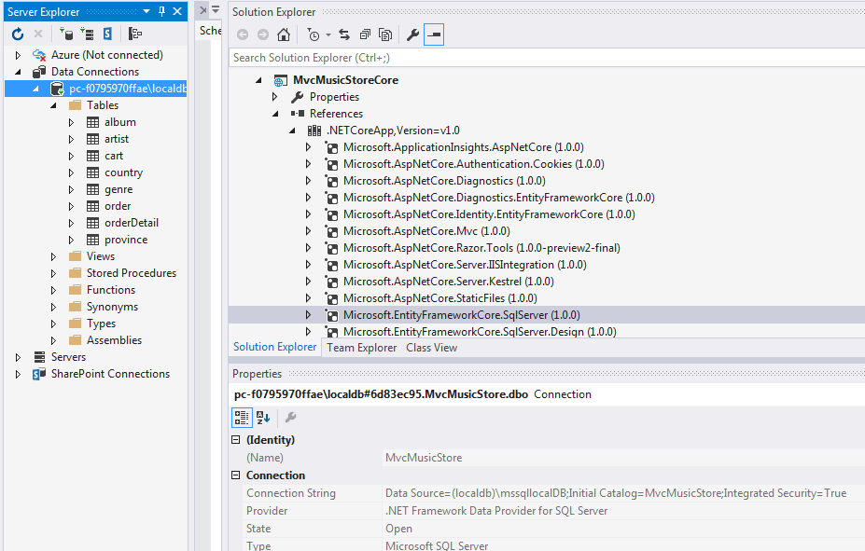
Trick for Connection Strings
Connect to the database using Visual Studio's Server Explorer
Then, look at its properties for the connection string
Look in references for the Provider
The prior screen used the term Database, while this method uses Initial Catalog.
Both work, but I think Database is used when referring to non-Microsoft databases

Slide 24

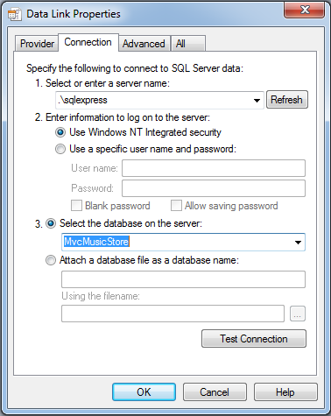
Older Trick for Connection Strings
Create a file with a .udl extension like fred.udl
Double-click it to see a form for data link properties
Enter the server\instance & select the database
Open the file to see the connection string
This doesn't work for (localDB)\MsSqlLocalDB
Possibly because SQL Express 2016 is not installed
… so use .\sqlexpress instead
Delete the provider part … rest should be OK
Let me know if this works
[oledb]
; Everything after this line is an OLE DB initstring
Provider=SQLOLEDB.1;Integrated Security=SSPI;Persist Security Info=False;Initial Catalog=MvcMusicStore;Data Source=.\sqlexpress

Slide 25
Resulting context class - represents a session with the database - to query & retrieve instances of the entity classes
using System;
using Microsoft.EntityFrameworkCore;
using Microsoft.EntityFrameworkCore.Metadata;
namespace MvcMusicStoreCore.Models
{
public partial class MvcMusicStoreContext : DbContext
{
protected override void OnConfiguring(DbContextOptionsBuilder optionsBuilder)
{
optionsBuilder.UseSqlServer(@"Server=(localdb)\mssqllocaldb;Database=MvcMusicStore;Trusted_Connection=True;");
}
protected override void OnModelCreating(ModelBuilder modelBuilder)
{
…bunch of ModelBuilder/Entity<…> stuff
}
public virtual DbSet<Album> Album { get; set; }
public virtual DbSet<Artist> Artist { get; set; }
public virtual DbSet<Cart> Cart { get; set; }
public virtual DbSet<Country> Country { get; set; }
public virtual DbSet<Genre> Genre { get; set; }
public virtual DbSet<Order> Order { get; set; }
public virtual DbSet<OrderDetail> OrderDetail { get; set; }
public virtual DbSet<Province> Province { get; set; }
}
}
We're going to replace this in a moment
This describes the entities (tables) and their relationships
These identify the tables in the database and the model class that describes their records (objects of the class)

Slide 26
Resulting class for Album table
using System;
using System.Collections.Generic;
namespace MvcMusicStoreCore.Models
{
public partial class Album
{
public Album()
{
Cart = new HashSet<Cart>();
OrderDetail = new HashSet<OrderDetail>();
}
public int AlbumId { get; set; }
public int GenreId { get; set; }
public int ArtistId { get; set; }
public string Title { get; set; }
public float Price { get; set; }
public string AlbumArtUrl { get; set; }
public virtual ICollection<Cart> Cart { get; set; }
public virtual ICollection<OrderDetail> OrderDetail { get; set; }
public virtual Artist Artist { get; set; }
public virtual Genre Genre { get; set; }
}
}
Notice the namespace & "partial" class … these become really important when doing validation.
Physical properties of objects instantiated from this class
Relationships to other tables in the database are "virtual" because they are only provided if you ask for them while reading from the table

Slide 27
Register the Context with Dependency Injection
Dependency
Some components depend on services to work
Dependency Injection
Instantiates, configures & provides service(s) to the component's constructor
Each controller needs a context … a session with the database
…and each context needs a connection string
→ centralise the connection string in appsettings.json
Register the context and its connection string parameter in Startup.cs
A service instantiated & ready to be injected when required

Slide 28
Modify the Context: add a constructor
Remove/comment the OnConfiguring method
Add a constructor
That expects one or more parameters (such as a connection string)
(these are provided by Dependency Injection when it instantiates the context)
public partial class MvcMusicStoreContext : DbContext
{
protected override void OnConfiguring(DbContextOptionsBuilder optionsBuilder)
{
#warning …
optionsBuilder.UseSqlServer(@"Server=(localdb)\mssqllocaldb;Database=MvcMusicStore;Trusted_Connection=True;");
}
Replace this … with this
public MvcMusicStoreContext(DbContextOptions<MvcMusicStoreContext> options)
:base(options)
{ }

Slide 29
Centralise the connection string … did you remember to copy it before deleting it from the context?
Put this into appsettings.json
… alongside the default connection string
{
"ApplicationInsights": {
"InstrumentationKey": ""
},
"ConnectionStrings": {
"MvcMusicStoreConnection": "Server=(localdb)\\mssqllocaldb;Database=MvcMusicStore;Trusted_Connection=True;",
"DefaultConnection": "Server=(localdb)\\mssqllocaldb;Database=aspnet-MvcMusicStoreCore-9b4191a9-84bc-4996-8…"
},
"Logging": {
"IncludeScopes": false,
"LogLevel": {
"Default": "Debug",
"System": "Information",
"Microsoft": "Information"
}
}
}
This is the default connection used by user/role authentication and, occasionally, for the code-first approach database

Slide 30
Register & Configure Context in Startup.cs …as a service
public void ConfigureServices(IServiceCollection services)
{
// Add framework services.
services.AddApplicationInsightsTelemetry(Configuration);
// enable dependency injection for context of MvcMusicStore database
services.AddDbContext<MvcMusicStoreContext>(options =>
options.UseSqlServer(Configuration.GetConnectionString("MvcMusicStoreConnection")));
services.AddDbContext<ApplicationDbContext>(options =>
options.UseSqlServer(Configuration.GetConnectionString("DefaultConnection")));
Add a service reference to instantiate the context and provide its connection string
Yes, you could just replace the “Configuration.GetConectionString(…)” with the actual string, but I like following convention so others can predict where I store stuff.
I'm guided by the Default Connection stuff that's generated …

Slide 31
Generating a Controller & Views

Slide 32
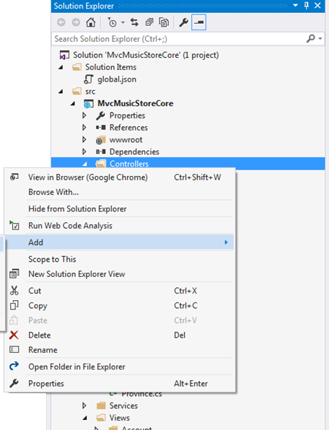
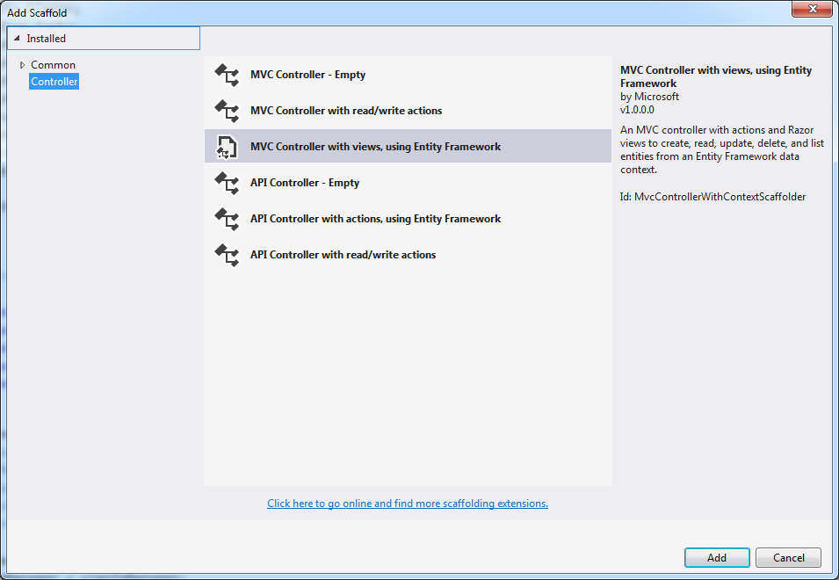
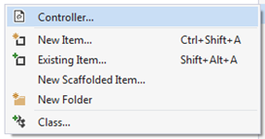
Create a Controller for the Albums Model - decide how much to generate

Slide 33
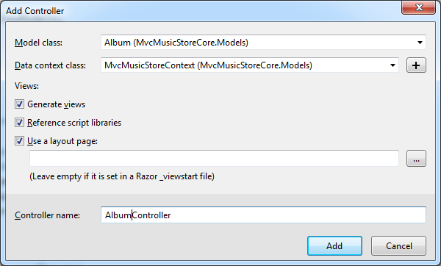
Provide the target class (table) and context if requested
Generate views
Create appropriate view for each action:
Index (list), Detail (single record), Create, Edit, Delete
Reference script libraries
Adds jQuery scripts for data validation on Create & Edit pages
Use a layout page
Views are loaded into a "master page"
To easily provide a consistent look
Default layout is identified in ~\Views\ViewStart.cshtml

Slide 34
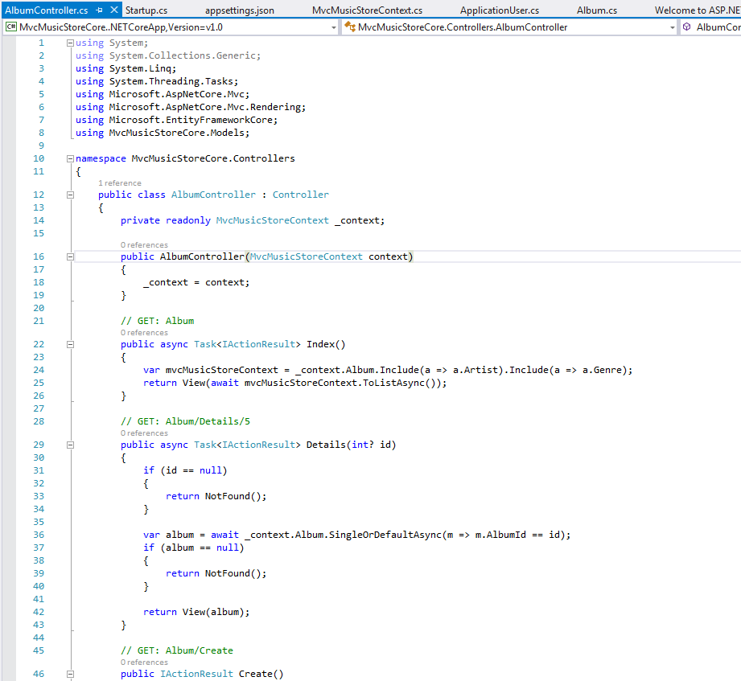
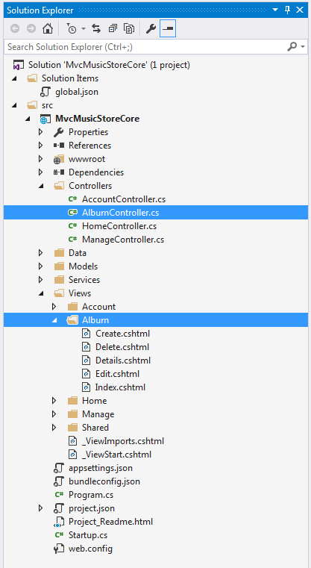
context is provided by Dependency Injection, defined in Startup.cs
Views are named after their action, in sub-folder named after their controller
This tells Razor where the default layout is

Slide 35
Asynchronous Actions in Controllers
IIS has a finite number of process threads
A very active site will either ignore, drop or backlog requests
Users get "Timeout", "Unavailable", "Forbidden" or "Not Found" errors
By default, generated actions fork asynchronous tasks
Releasing resources while waiting on requests to the database server
This allows sites to scale to a very large number of users
// GET: Album
public async Task<IActionResult> Index()
{
var mvcMusicStoreContext = _context.Album.Include(a => a.Artist).Include(a => a.Genre);
return View(await mvcMusicStoreContext.ToListAsync());
}

Slide 36
Controller Actions (cont'd)
Index action
Default is to list all records in the table, ordered by key
Details action
Shows all fields for the selected record (key is passed as "id")
When records have many fields, the index view is often restricted to 5 or 6
Create actions
One to display a blank input page
And set up drop-downs for foreign keys
One, requiring HTTP Post, adds the new record to the table
Differentiated by receiving parameters
The [HttpPost] attribute restricts this to a <form> with action="POST"

Slide 37
Controller Actions (cont'd)
Edit actions
One to display the selected record for update
One, requiring HTTP POST, to save the updated record to the table
Again: differentiated by parameters
Delete actions
One to display the selected record to confirm the delete
One, requiring HTTP POST, to delete the record after confirmation
This has the same parameter as the confirm page
So it has a different name to differentiate it
[HttpPost, ActionName("Delete")] relates it to a Delete post-back request

Slide 38
The setup Create action - similar for Edit
Go to the context and get all records from the Artist table
When user selects an item in the drop-down, return the field "ArtistId"
// GET: Album/Create
public IActionResult Create()
{
ViewData["ArtistId"] = new SelectList(_context.Artist, "ArtistId", "Name");
ViewData["GenreId"] = new SelectList(_context.Genre, "GenreId", "GenreId");
return View();
}
In the drop-down, display the field in Artist called "Name"
Create setup action
Creates two variants in ViewData for drop-downs on the View
One with all artists and one with all genres
& identifying fields from the artist records to:
Display to the user
Return as the value of the drop-down
Calls a view, without passing an album record as the "model"
Input areas on the view will be blank

Slide 39
The post-back Create Action - similar for Edit
Responds only to an HTTP POST request for action Create
[HttpPost]
[ValidateAntiForgeryToken]
public async Task<IActionResult> Create([Bind("AlbumId,AlbumArtUrl,ArtistId,GenreId,Price,Title")] Album album)
{
if (ModelState.IsValid)
{
_context.Add(album);
await _context.SaveChangesAsync();
return RedirectToAction("Index");
}
ViewData["ArtistId"] = new SelectList(_context.Artist, "ArtistId", "Name", album.ArtistId);
ViewData["GenreId"] = new SelectList(_context.Genre, "GenreId", "GenreId", album.GenreId);
return View(album);
}
Checks for a one-time anti-forgery/anti-replay token on the page
May invoke an asynchronous background task, returning a request to continue
If the data passes the model's validation criteria, then…
Queue it to be added to the database
Then commit/implement the add
Return to the Index page, which lists all records in the table
Pre-select the entries input by the user
This is the "sad" path … it failed model validation
Set up the collections again for the drop-downs
Return to the view
…but this time, provide a model with the user's input and error messages, so they can correct it.

Slide 40
About parameters to the post-back action
Create([Bind("AlbumId,AlbumArtUrl,ArtistId,GenreId,Price,Title")] Album album)
[Bind(…)]
Only look for the listed variable names in the flow from the browser
…so nasties don't inject things we're not expecting into the Album object
Album album
Since "album" is a complex object of the Album class:
"Binder" will discover its properties
…and map like-named fields in the browser flow to them
You can have multiple parameters to an action
Including primitives like Int32 and Boolean
If an incoming (string) field can't be converted to the expected primitive datatype…
…you die a horrible death
Binder will map parameters by name to fields in the flow from the browser
Missing fields are null → that's why primitive parameters need Int32? or default values

